Slide 1
Identifying Factors That Have Impact On Kid’s Performance
Dini Anggriyani / milestone 2 phase 1

Slide 2
Presentation Outline
Problem Background
EDA
Presentations
Web Applications
Base Model Comparison
Model Tuning

Slide 3
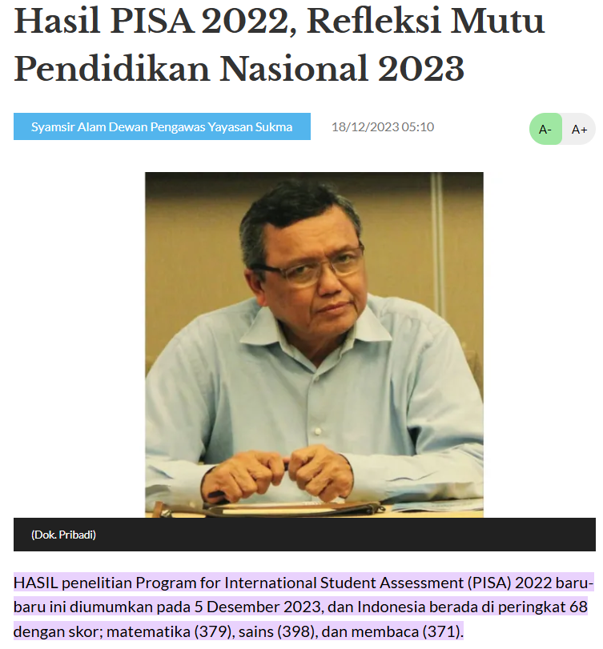

Problem Background This program aims to help student identifying factors that have impacts on their performance and giving suggestions to parents for preparing school, facilities, and mental support for boosting their children’s performances on school

Slide 4
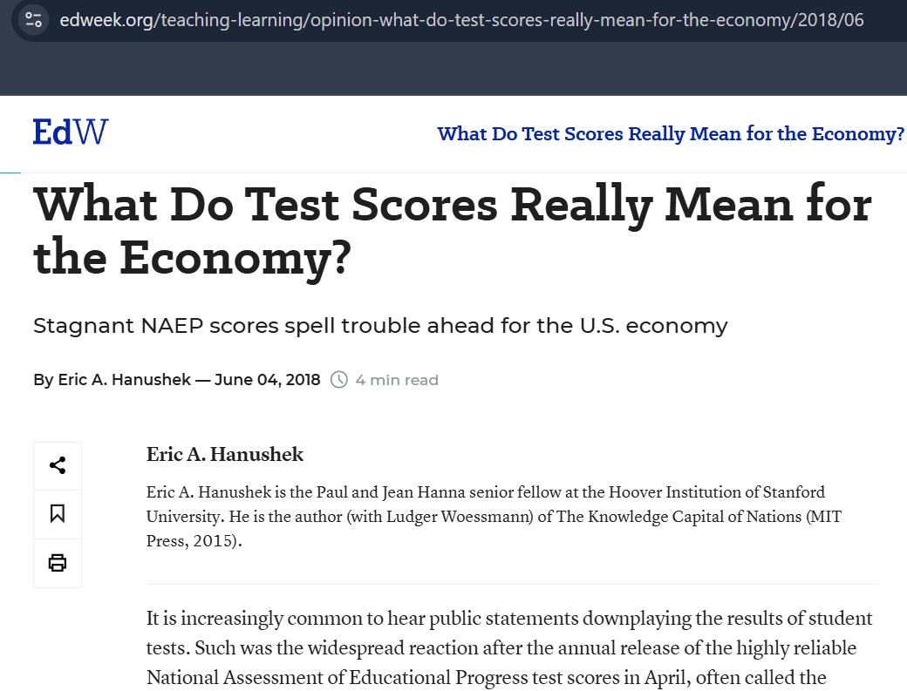
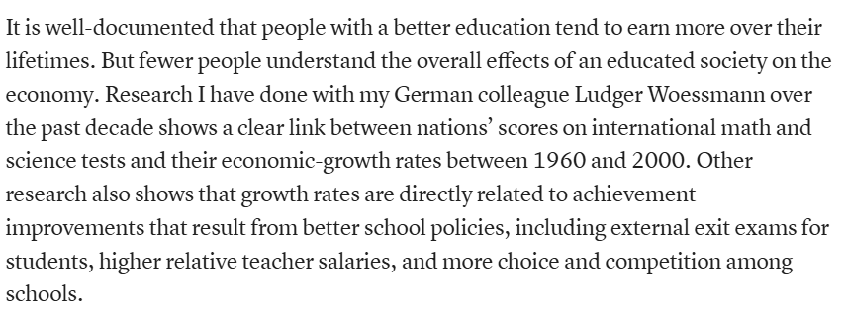
Problem Background This program aims to help student identifying factors that have impacts on their performance and giving suggestions to parents for preparing school, facilities, and mental support for boosting their children’s performances on school

Slide 5
No. | Columns | Data Type | Distribution Type
1 | Hours_Studied | Integer | Normal
2 | Attendance | Integer | Normal
3 | Parental_Involvement | Object | -
4 | Access_to_Resources | Object | -
5 | Extracurricular_Activities | Object | -
6 | Sleep_Hours | Integer | Normal
7 | Previous_Scores | Integer | Normal
8 | Motivation_Level | Object | -
9 | Tutoring_Sessions | Integer | Skewed
10 | Family_Income | Object | -
11 | Teacher_Quality | Object | -
12 | School_Type | Object | -
13 | Peer_Influence | Object | -
14 | Physical_Activity | Integer | Normal
15 | Learning Disabilities | Object | -
16 | Parental_Education_Level | Object | -
17 | Disctance_From_Home | Object | -
18 | Exam_Score | Integer | Skewed

Slide 6
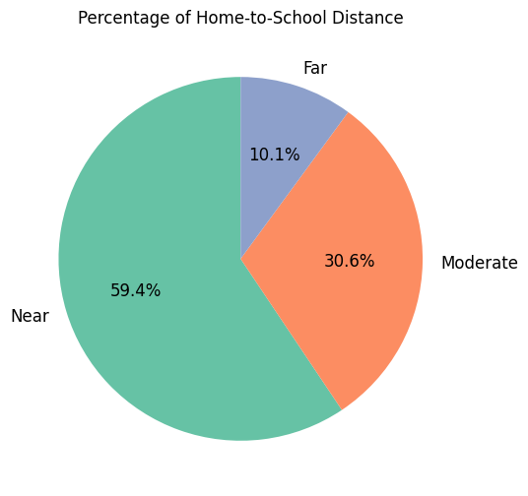
EDA Percentage of Distance from Home to School
Insight:
About 10.1% parents choose to send their children to school that has far distance from their home while 30.64% choose school that has moderate distance. This phenomenon may due to the quality of the school as the main reason in deciding which school they send their children into

Slide 7
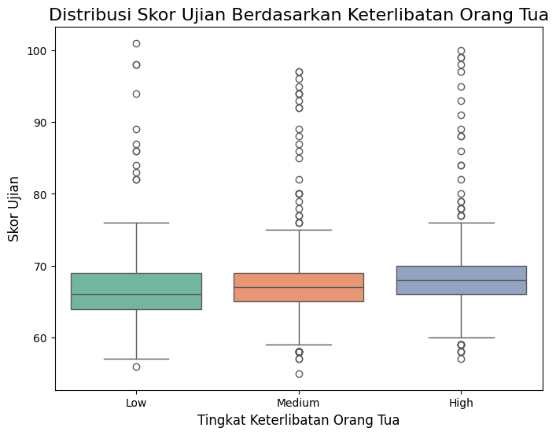
EDA Do children Who Perform Well in School Have Active Parental Involvement?
Insight: Parental involvement do have impact on their children’s performance in school. Children with high parental involvement tends to have better performance at school compare to those with low parental involvement

Slide 8
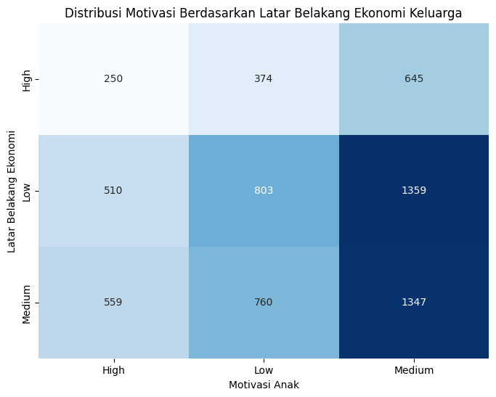
EDA Does Family Economy Background has Influence on Children Performances?
Insight:
Children with medium family economic background tend to have the highest motivation while children with low economic background tend to have the lowest motivation

Slide 9
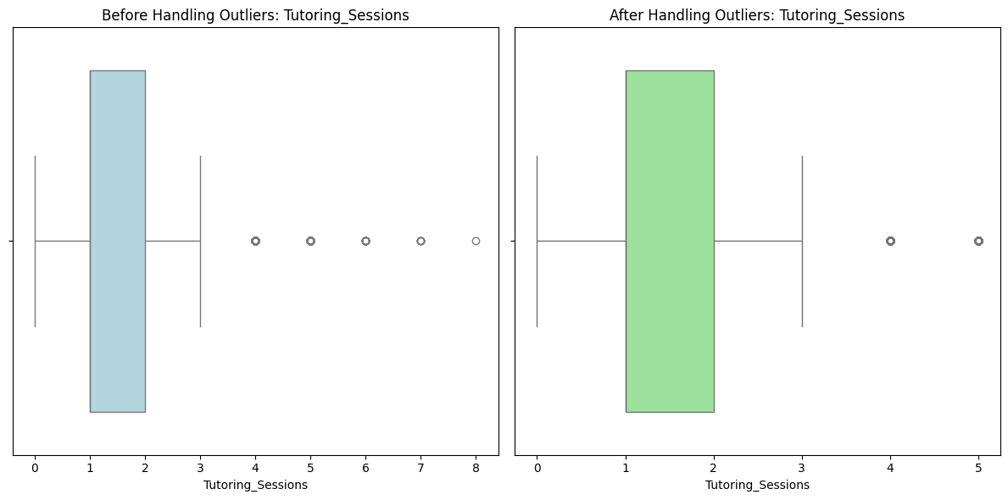
Tukey’s Rule
Outliers: 6.5%

Slide 10
Model Evaluation
 | KNN | SVR | Decision Tree | Random Forest | XGBoost
R2 Score | 0.18594 | 0.603872 | 0.102046 | 0.539666 | 0.529093
 | KNN | SVR | Decision Tree | Random Forest | XGBoost
Mean | -0.288128 | -0.710699 | -0.138931 | -0.641537 | -0.629374
Std | 0.023390 | 0.071826 | 0.052473 | 0.060751 | 0.062798

Slide 11
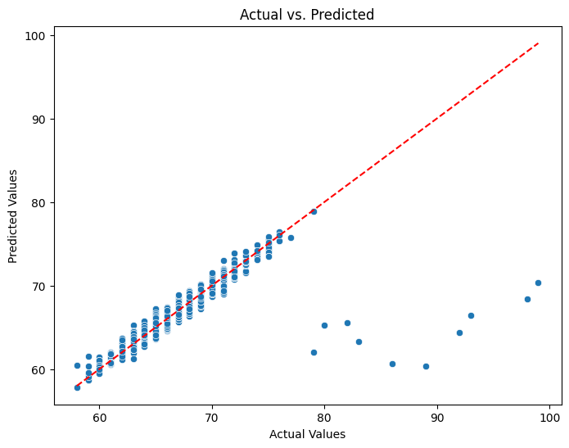
Model Tuning
Parameter
SVR_kernel | Linear, rbf, poly
SVR_C | 0.1, 1, 10, 100
SVR_gamma | 0.001, 0.01, 1
Train Test | 0.717
Test Set | 0.601
Diff | 0.116

Slide 12
Conclusion
- For parents:
When choosing which school you’re deciding to register your kid into, try not only look after the quality of the school but considering the distances between home and school because the kid’s performances goes down as the distances increases
Parents should also actively involve in growth and development of their kids by providing mental support, giving the best facilities, etc. Parental involvement has linear correlation with kid’s performances on school
For those who are planning to have kid, try to improve your quality through increasing income and higher education (Collage, postgraduate) for higher parent education can be a great example and motivation for their kids
- For Students:
Try to focus on things that you can control such as study hours and attendances. Eventhough it’s not always have linear correlation, with increasing those two thing can sure reducing the chence to failed at school
Be ware of your sleep time. Avoid staying up late if it not necessary
Try involving in one or two extracurriculers to make a variances in day to day activity. Involving in too many extracurriculers can have negative impact on school performances
-Model Evaluation:
The model is quite good and stable. Increasing its performances can be done by adding data or adjusting data used in model through Feature Selection

Slide 13
Web Aplications
https://huggingface.co/spaces/dini15/Student_Performace_Predictions

Slide 14


